Slide 1
Pietro I. Cassinadri
Architect

Slide 4
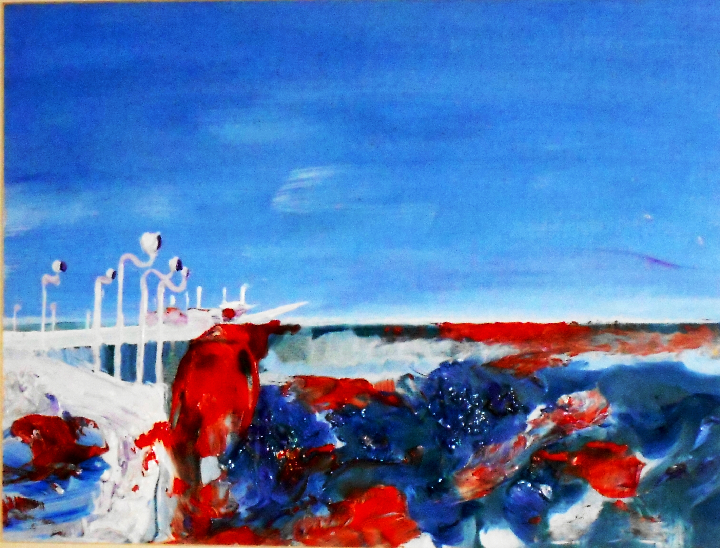

Slide 5
