Slide 1
Pietro I. Cassinadri
Architect

Slide 2
Library Renovation 92
E-Level MSB
University of Cincinnati

Slide 3
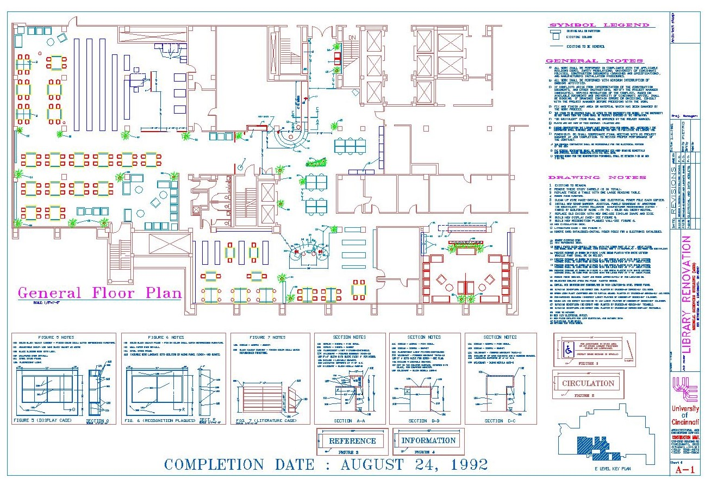

Slide 4
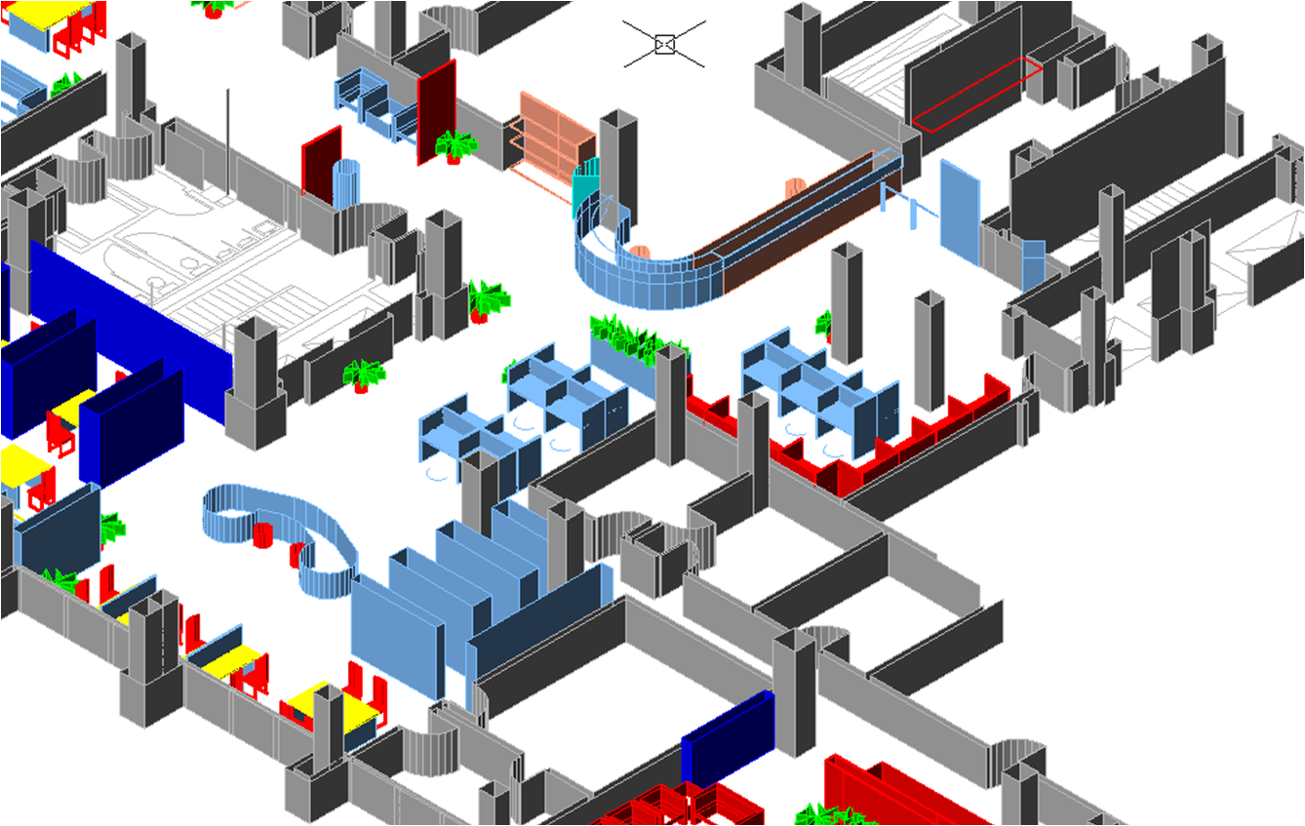

Slide 5
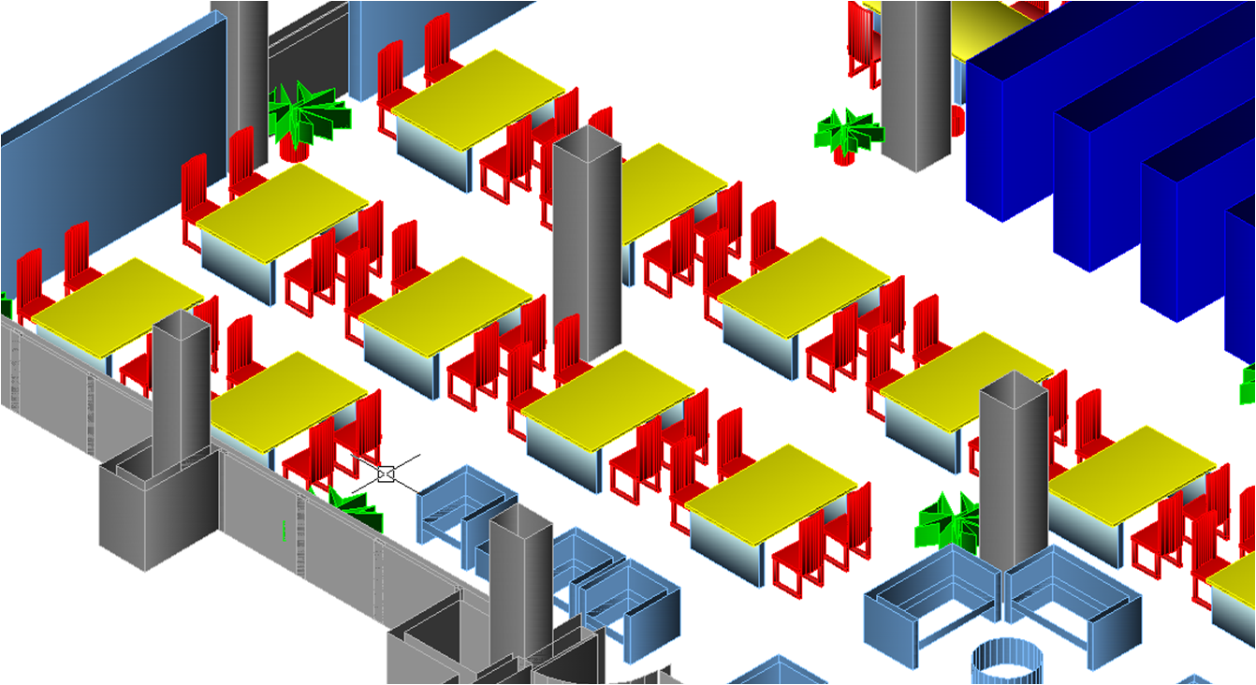

Slide 6
